Slide 2
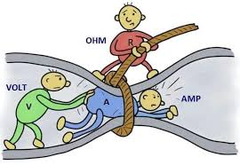
What is voltage?
Voltage, often measured in volts (V), is the electrical potential difference between two points in a circuit. It represents the force that drives electric current.
What is current?
Current, measured in amperes (A), is the flow of electric charge in a circuit. It is the rate at which electric charges (usually electrons) move through a conductor.
What is resistance?
Resistance, measured in ohms (ΩΩ, is the opposition that a material offers to the flow of electric current. It depends on the material’s properties, length, cross-sectional area, and temperature.
How are voltage, current, and resistance related?
They are related by Ohm’s Law, which states that voltage (V) is equal to the product of current (I) and resistance (R) in a circuit: V=I×R. This relationship helps to understand how changes in one of these parameters affect the others.

Slide 3
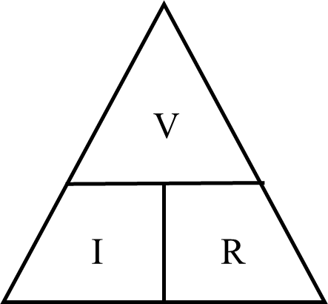
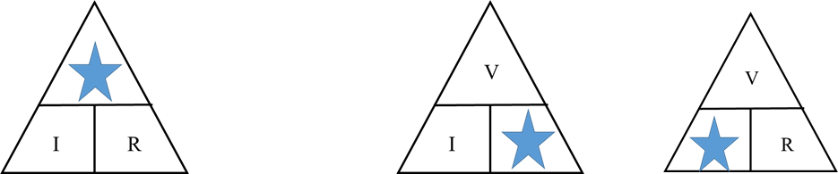
Ohm’s Law
Ohm’s law states that the current (I) flowing through a circuit is directly proportional to the potential difference (V) across the circuit and inversely proportional to the resistance (R) of the circuit provided the temperature remains constant.
Mathematically, I=V/R ……… (1)
V=IR………… (2)
R=V/I …………(3)
The magic triangle
V
R
I

Slide 4
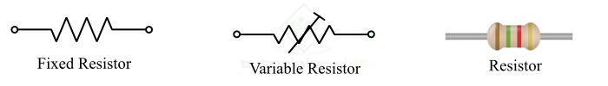


What is an Electric Circuit?
An Electric Circuit is a closed path for transmitting an electric current through the medium of electrical and magnetic fields. The flow of electrons across the loop constitutes the electric current.
Basic Circuit Elements:
Active Circuit Elements: Active Elements are those which can generate energy. Examples include batteries, generators, operational amplifiers and diodes. Note that in an electrical circuit, the source elements are the most significant active elements.
Resistor: A resistor opposes the flow of current through it.
Inductor: An inductor stores energy in form of the electromagnetic field.
Capacitor: A capacitor stores energy in form of the electrostatic field. The voltage across a capacitor is proportional to the charge.

Slide 5
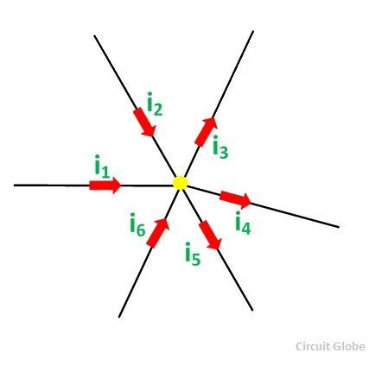
Kirchhoff’s Law
Kirchhoff’s Current Law
Kirchhoff’s Current Law states that” the algebraic sum of all the currents at any node point or a junction of a circuit is zero”. Σ I = 0
Considering the above figure as per the Kirchhoff’s Current Law:
i₁ + i₂ – i₃ – i₄ – i₅ + i₆ = 0 ……… (1)
The direction of incoming currents to a node is taken as positive while the outgoing currents are taken as negative. The reverse of this can also be takenThe equation (1) can also be written as:
i₁ + i₂ + i₆ = i₃ + i₄ + i₅
Sum of incoming currents = Sum of outgoing currents
According to the Kirchhoff’s Current Law, the algebraic sum of the currents entering a node must be equal to the algebraic sum of the currents leaving the node in an electrical network.

Slide 6
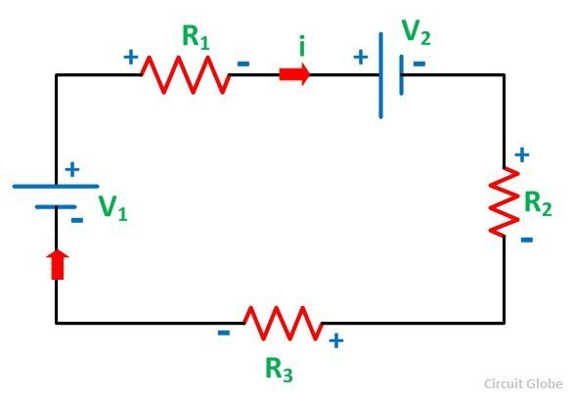
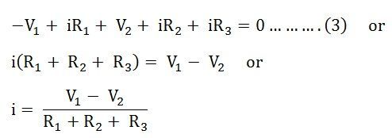
Considering the other figure shown below and assuming the direction of the current i
Kirchhoff’s Voltage Law
Kirchhoff’s Voltage Law states that the algebraic sum of the voltages (or voltage drops) in any closed path of a network that is transverse in a single direction is zero.
In other words, in a closed circuit, the algebraic sum of all the EMFs and the algebraic sum of all the voltage drops (product of current (I) and resistance (R)) is zero.
It is seen that the voltage V₁ is negative and V₂ is positive
For the dependent sources in the circuit, KVL can also be applied.

Slide 7
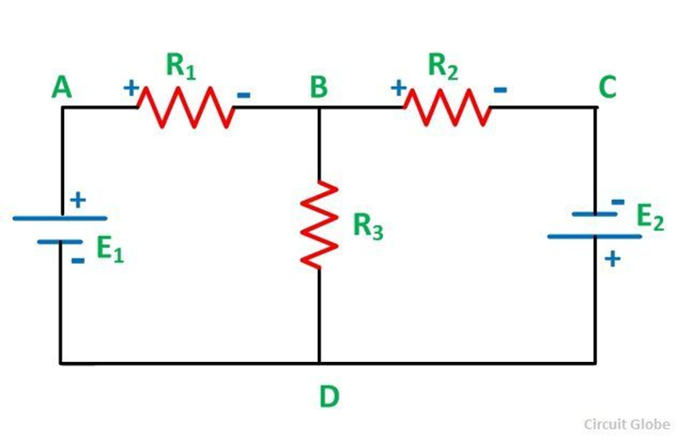
A node is a point in the network or circuit where two or more circuit elements are joined. For example, in the above circuit diagram, A and B is the node points.
A junction is a point in the network where three or more circuit elements are joined. It is a point where the current is divided. In the above circuit, B and D are the junctions.
Branch is the part of a network, which lies between the two junction points is called a Branch. In the above circuit DAB, BCD and BD are the branches of the circuit.
A closed path of a network is called a loop. ABDA, BCDB are loops in the above circuit diagram shown.
The most elementary form of a loop which cannot be further divided is called a mesh.

